Slide 1
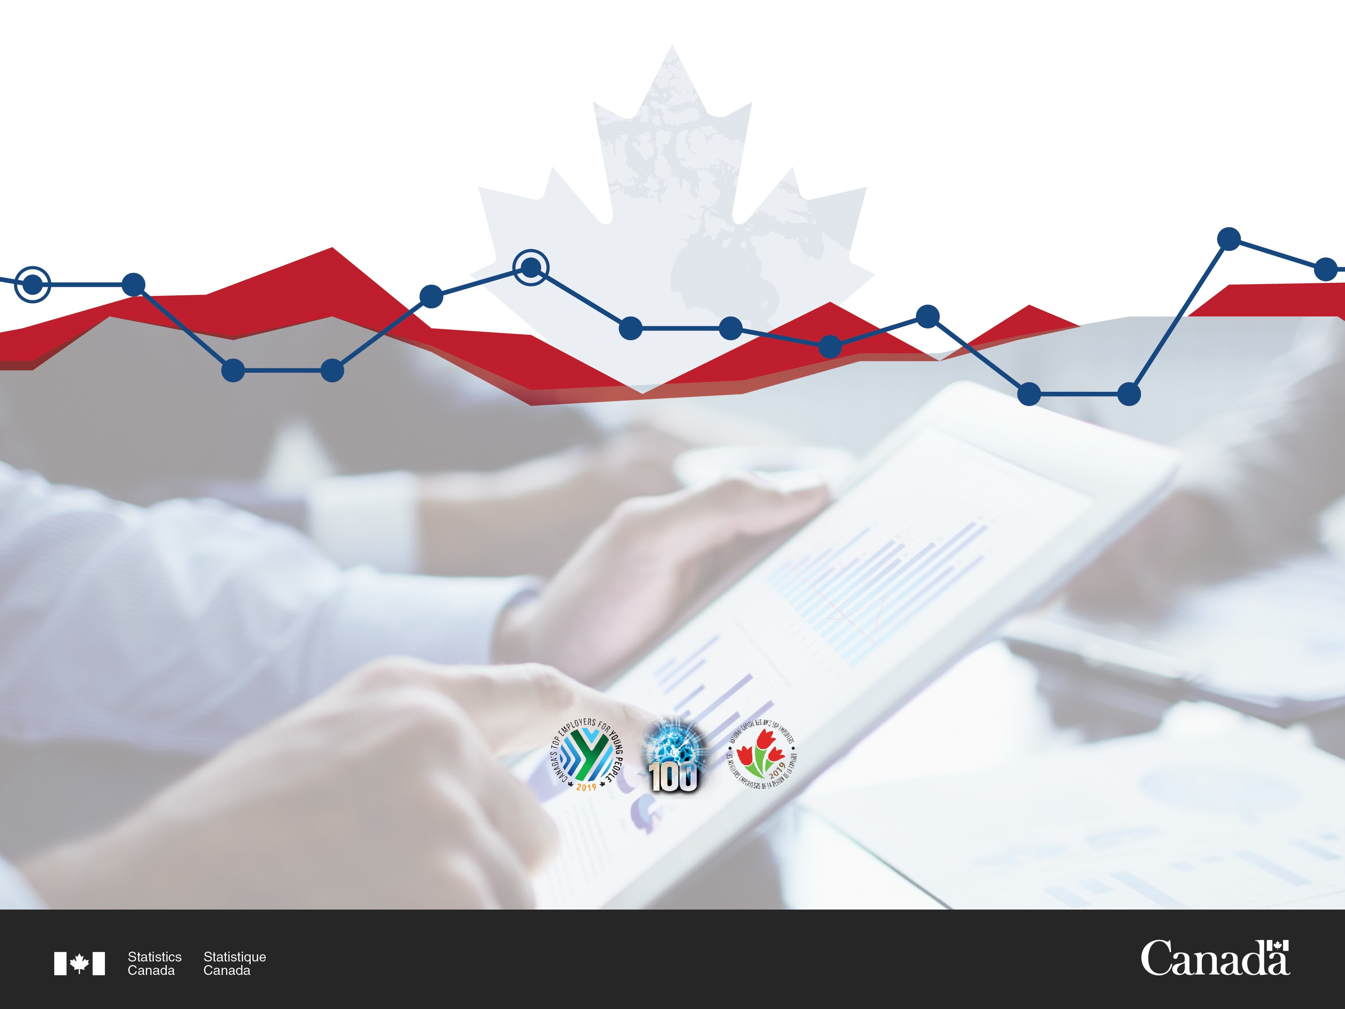
Statistics Canada’s Innovation Ecosystem
Kathryn Stevenson, Innovation Lead
Analytical Studies, Methodology and Statistical Infrastructure Field
Mai 2019

Slide 2

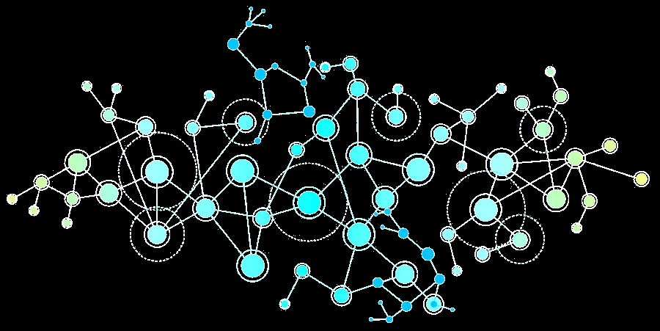
Statistics Canada’s Innovation Ecosystem
Agile, inclusive and equipped
Data,
Mindsets
and
Behaviours
2

Slide 3
StatCan Innovation Ecosystem Outcomes
All employees understand what they are supposed to innovate (want to, can do, allowed to). Vision, mission and strategic direction have been clearly articulated, broadly communicated + reinforced through formal/informal mechanisms
All employees can access information, tools and training necessary to stimulate, promote and advance timely execution of Innovation experiments.
Lessons learned from Innovation experiments are openly disseminated to all employees to accelerate progress, assess value and manage risk on path to meeting strategic goals.
3

Slide 4
StatCan Innovation Ecosystem Outcomes (2)
Multi-disciplinary project teams value diversity, actively manage risk (rather than seek to eliminate it) and seek talent, knowledge and insights through partnerships and engagement with end users.
Innovation team members bring agility and ambition to both promote the art of the possible – transformational, not just incremental gains – and execute to deliver results. Team members share knowledge and build capacity among colleagues to promote adoption of new approaches, risk appetite and sound project management.
4

Slide 5
StatCan Innovation Ecosystem has formal structures including…
ADM-level Innovation champion
Governance: ADM/DG-level Modernization Management Committee
Data Science Centre of Excellence
Data Science Accelerator
Digital Innovation team
Pathfinder projects
Centres of Expertise (BI tools, geomatics,
open data)
Innovation Team
5

Slide 6
And informal ones including…
Communities of Practice:
Geomatics
Data Analytics
Machine Learning
Power BI
Data Documentation Initiative (data standards)
LEAN
Machine Learning
R
Digital Lounge – Emerging tools 101
Lunch & learn – Agile, Foresight…
6

Slide 7
Some enterprise-wide initiatives…
Safe Outputs
Safe Settings
Safe Projects
Safe People
Safe Data
Big Ideas Conferences
Innovation Channel – crowdsourcing tool
Analytical Projects Initiative
Corporate Innovation Fund
R+ D Board
5 SAFES
"Five Safes Wikipedia"
7

Slide 8
And beyond…with Innovation hackathons
Partnering with various departments, other levels of government, academia and others on time-boxed challenges to mobilize data and talent and build new skillsets…while ‘hacking’ bureaucracy…
8

Slide 9
Partnership opportunities – let’s talk!
statcan.innovationcoordinator-coorddelinnovation.statcan@canada.ca
Kathryn.Stevenson
@canada.ca
9

